Slide 1


SRI SIDDHARTHA INSTITUTE OF TECHNOLOGY
(A Constituent College of Sri Siddhartha Academy of Higher Education)
MARALUR, TUMAKURU-572105
Department of Computer Science And Engineering
PHASE 1
PROJECT PRESENTATION ON
“PROJECT MANAGEMENT APP”
Submitted by:-
Shreyas T M -18CS088
Rakesh Honnamore -18CS071
Vinod S C -18CS114
Sahana B D -18CS079
Under the guidance of :-
MADHUMALA G
Assistant Professor, CSE Dept.
SSIT,Tumakuru.
Date :- 05/01/2022

Slide 2
CONTENTS
ABSTRACT
PROJECT OVERVIEW
SOURCES
WORKFLOW
MODULES
REQUIREMENTS
CONCLUSION
BIBLIOGRAPHY

Slide 3
ABSTRACT
The Mobile Technology.
Conventional methods to Apps.
Thus we are proposing the Project Management App.

Slide 4

PROJECT OVERVIEW
Selection of the project ?
Need of the project ?
Use of the project ?

Slide 5


Slide 6
Sources
The user stories and plans are collected from respective Guide, Project coordinator, HOD ,and other faculties.
This helped us to open up for a new view of the working of App.

Slide 7
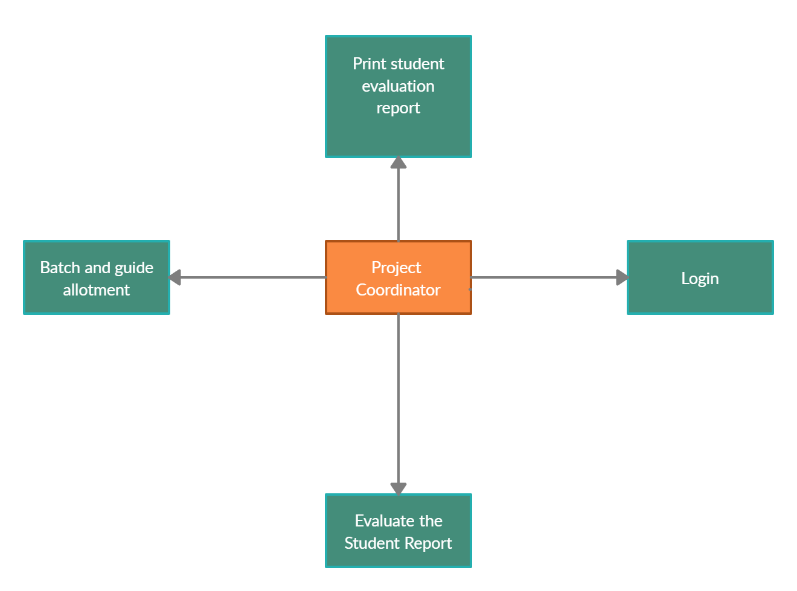
PROJECT COORDINATOR MODULE

Slide 8
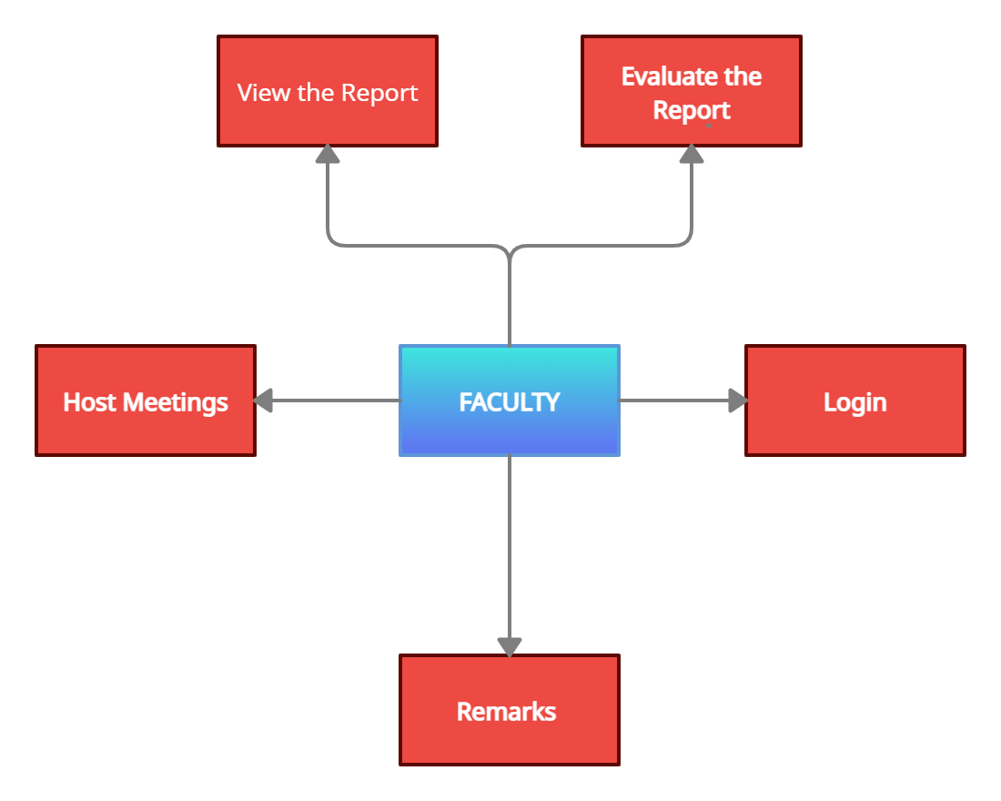
FACULTY MODULE

Slide 9
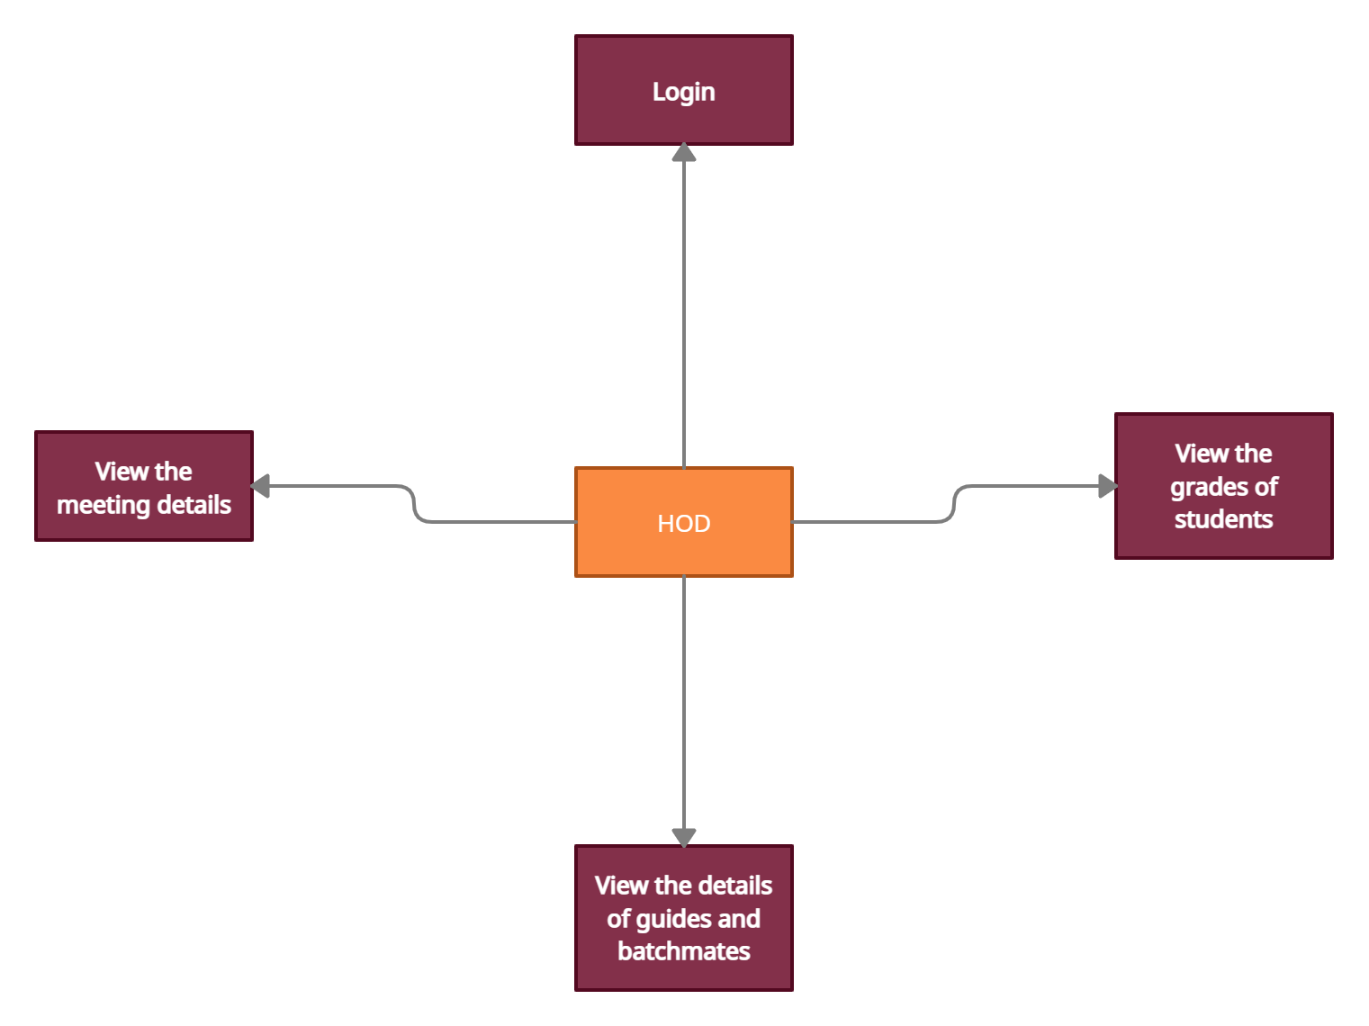
HOD MODULE

Slide 10
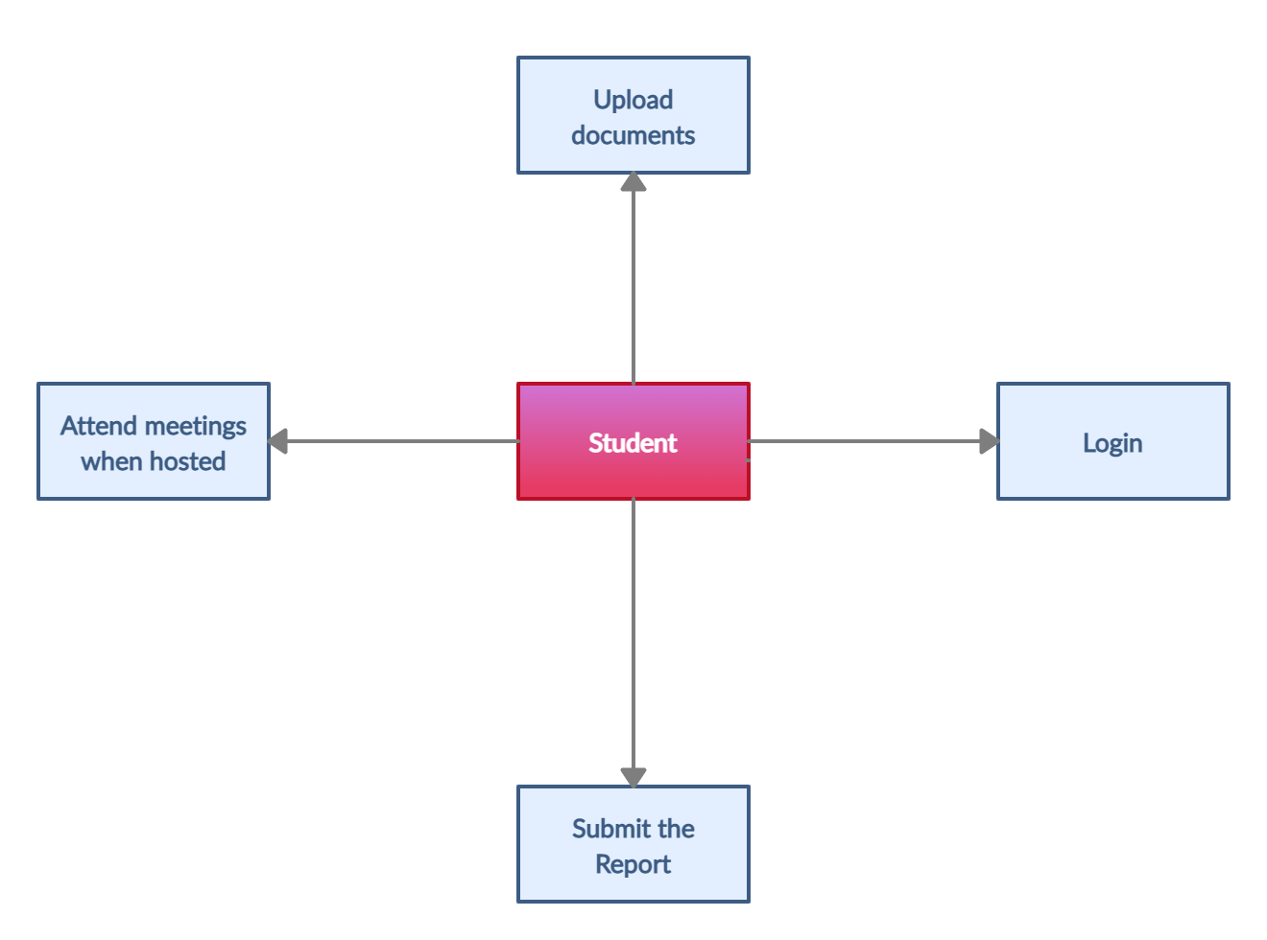
STUDENT MODULE

Slide 11
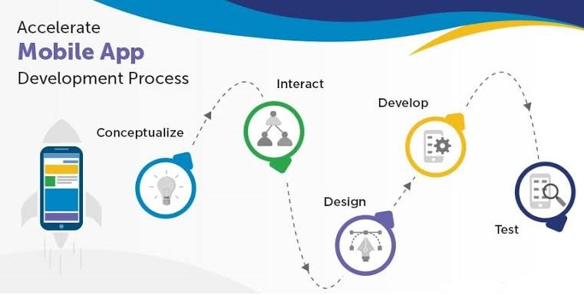
WORKFLOW

Slide 12
REQUIREMENTS
Android
Android Inc. was founded in palo Alto , California in October 2003 by Andy Rubin , Rich Miner , Nick sears , Chris White.
In July 2005, Google acquired Android Inc. for at least $50 million.
System requirements

Slide 13
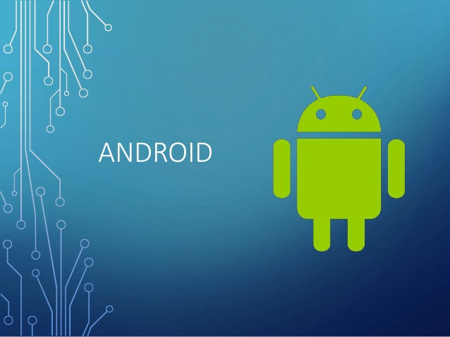
CONCLUSION
By the end of this project ,the project management can be done virtually. Through this the faculty , project coordinator and student connect virtually and discuss about the project.

Slide 14
BIBLIOGRAPHY
https://creately.com/
https://developer.servicenow.com/dev.do#!/
https://flutter.dev/development.com/

Slide 15
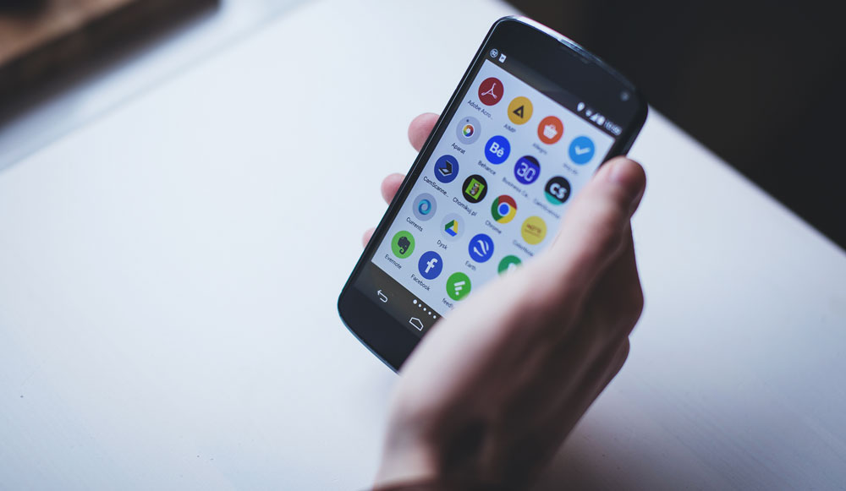
THANK YOU

